Slide 1

Completing
Puppet Installation
and Writing Your First Puppet Module
2018 Sixth International Free Movement Palestine Marathon

Slide 2

XSEDE
XSEDE is a single virtual system that scientists can use to interactively share computing resources, data and expertise. People around the world use these resources and services — things like supercomputers, collections of data and new tools — to improve our planet.
Please go to https://www.xsede.org/ and register
After you register, send me your XSEDE ID so I can add you to our project

Slide 3
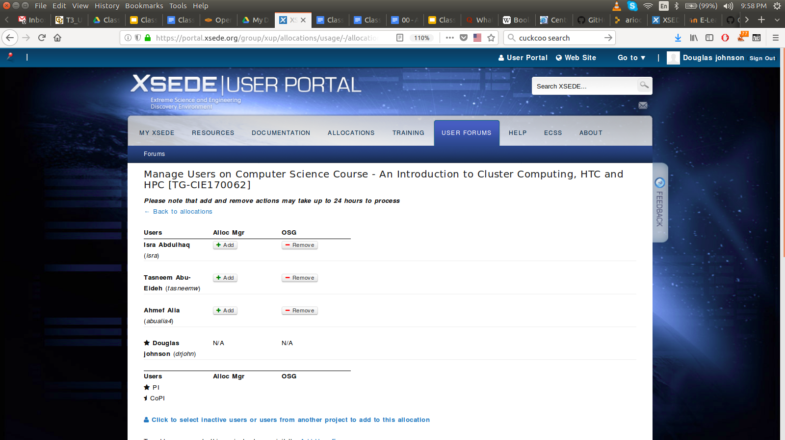

Slide 4
Review:
Puppet Installation and Configuration:
Installed Puppet Server
Installed Puppet Client
Installed two modules
roles - Steering module for puppet
motd - Updated /etc/motd
Ran puppet agent -t to update /etc/motd on Puppet Client

Slide 5
Puppet Modules
Are located in /etc/puppetlabs/code/environments/production/modules
Where the functionality is implemented
Puppet code is stored in manifests.
The files have extensions .pp
Puppet is language as well as a system
Code is written in classes
Supports inheritance
Classes can include other classes
You can only define a class or variable once
When Puppet Master runs it searches through all the .pp files in the modules area for classes

Slide 6
Pupper Master
node.sh
Class - role::type01
Class role::type02
Class role::type03
Class role::type04
Class profile::type01
Class profile::type02
Class profile::type03
Class profile::type04
Module A
Module B
Module C
Module D
Module E

Slide 7
Hierarchy of Puppet Modules
Use the inherits and include functionality of Puppet to create a hierarchy.
A Puppet module can inherit from another Puppet module and it can include any number of Puppet Classes
node.sh points to a specific role (class) given a host name
A role class points to (include) one and only one profile class
A profile class can include any number of Puppet Classes
A profile only uses inherits and include statements
A module (manifest) is where the real work is done

Slide 8
Three other important features:
Facts - Puppet’s cross-platform system profiling library. It discovers and reports per-node facts, such as its IP address, uptime, operating system, or whether it's a virtual machine. https://puppet.com/docs/facter/3.10/index.html
Hiera - Puppet’s built-in key/value data lookup system. By default, it uses simple YAML or JSON files. Almost every successful Puppet user relies on it heavily, and you should too. https://puppet.com/docs/puppet/4.10/hiera_intro.html
Templates - Documents that combine code, data, and literal text to produce a final rendered output. The goal of a template is to manage a complicated piece of text with simple inputs. https://docs.puppet.com/puppet/4.2/lang_template.html
We have already used Facts and Tenplates with second version of motd
We will discuss these in more details in the future

Slide 9
Class 8 Agenda: Puppet Installation and Configuration 3
March 27, 2018 Objective: Finish Puppet and Install NFS Client In this class we will: To finish the initial Puppet Installation Install NFS and autofs on the Puppet Server Write Puppet module to install NFS/autofs on Puppet Client
Class Slides: Class 8 - Completing Puppet Installation and Writing Your First Module
Support documents for the in-class work:
In-class documentation: Class 6 - Puppet Installation and Configuration Class 7 - Introduction NFS and autofs Class 8 - Writing Your First Puppet Module
This work may take more than one class

